Slide 1


Geoffrey Bowles
6/12/2023

Slide 2

Contents
Executive Summary
Introduction
Methodology
EDA with Visualization
EDA with SQL
Interactive Maps with Folium
Plotly Dash Dashboard
Predictive Analytics
Results
Conclusion

Slide 3
Executive Summary
Summary of methodologies
Collect data using SpaceX REST API and web scraping techniques
Wrangle data to create success/failure outcome variable
Explore data with data visualization techniques
Analyze data with SQL
Explore launch site success rates and proximities to geographical markers
Visualize launch sites with most success and payload ranges
Build models to predict landing outcomes
Exploratory Data Analysis
Launch success has improved over time
KSC LC-39A landing site has the highest success rate
Orbits ES-L1, GEO, HEO, and SSO have a 100% success rate
Visualization/Analytics
Most launch sites are near the equator and all are close to the coast
Predictive Analytics
All models performed similarly
The decision tree model slightly outperformed the rest using the .best_score_

Slide 4
Introduction
Background
SpaceX, a leader in the space industry, strives to make space travel affordable for everyone. Its accomplishments include sending spacecraft to the international space station, launching a satellite constellation that provides internet access and sending manned missions to space. SpaceX can do this because the rocket launches are relatively inexpensive ($62 million per launch) due to its novel reuse of the first stage of its Falcon 9 rocket. Other providers, which are not able to reuse the first stage, cost upwards of $165 million each. By determining if the first stage will land, we can determine the price of the launch. To do this, we can use public data and machine learning models to predict whether SpaceX – or a competing company – can reuse the first stage.
Explore
How payload mass, launch shite, number of flights, and orbits affect landing success
Rate of successful landings over time
Best predictive model for successful landing

Slide 5

Section 1

Slide 6
Methodology
Steps
Data collection methodology
Rocket Launch Data from SpaceX API with Requests via Python
Falcon9 Launch Data from Wikipedia with BeautifulSoup via Python
Perform data wrangling
Data was processed with one-hot encoding via Python
Explore data using SQL and data visualization
Visualize data with Folium and Plotly Dash
Build predictive models using classification models to predict landing outcomes
How to build, tune, evaluate classification model

Slide 7
Data Collection
SpaceX API Data
Pulled data from the API using the Requests module in Python
Converted the JSON response into a Pandas dataframe using pd.json_normalize()
Created subsets of data using lists
Constructed a working dataframe from the subsets
Falcon9 Launch Data
Web scraped data from Wikipedia using the BeautifulSoup module in Python
Looped through all tables using soup.find_all()
Parsed each table and stored all information into a custom dictionary
Created a working dataframe using pd.from_dict()

Slide 8
Data Collection \ SpaceX API
Perform GET Request on SpaceX API
Convert JSON Response to Pandas Dataframe
Filter Dataset to Falcon 9 Launches
Fill Null Values in Dataset
GitHub Reference: https://github.com/omf-gbowles/ibm-ds-capstone/blob/master/01-spacex-data-collection-api.ipynb

Slide 9
Data Collection \ Web Scraping
Perform GET request of Falcon9 Launch Wiki page
Extract all column/variable names from the HTML table header
Create a data frame by parsing the launch HTML tables
GitHub Reference: https://github.com/omf-gbowles/ibm-ds-capstone/blob/master/02-spacex-data-collection-webscraping.ipynb

Slide 10
Data Wrangling
Calculate the number of launches on each site
Calculate the number and occurrence of each orbit
Calculate the number and occurrence of mission outcome per orbit type
Create a landing outcome label from Outcome column
GitHub Reference: https://github.com/omf-gbowles/ibm-ds-capstone/blob/master/03-spacex-data-wrangling.ipynb

Slide 11
EDA with SQL
Perform the following SQL queries to explore the data:
Select the distinct launch sites in the space mission
Select 5 records where the launch site begins with the string ‘CCA’
Display the total payload mass carried by boosters launched by NASA (CRS)
Display average payload mass carried by booster version F9 v1.1
List the date when the first successful landing outcome in ground pad was achieved
List the names of the boosters which have success in drone ship and have payload mass greater than 4000 but less than 6000
List the total number of successful and failure mission outcomes
List the names of the booster_versions which have carried the maximum payload mass
List the records which will display the month names, failure landing outcomes in drone ship, booster versions and launch sites for the months in 2015
Rank the count of successful landing outcomes between 6/4/2010 and 3/20/2017
GitHub Reference: https://github.com/omf-gbowles/ibm-ds-capstone/blob/master/04-spacex-eda-sql.ipynb

Slide 12
EDA with Data Visualization
Charts
Flight Number vs. Payload
Flight Number vs. Launch Site
Payload Mass (kg) vs. Launch Site
Payload Mass (kg) vs. Orbit Type
Analysis
View relationships by using scatter plots
Show comparisons among discrete categories with bar charts
GitHub Reference: https://github.com/omf-gbowles/ibm-ds-capstone/blob/master/05-spacex-eda-data-viz.ipynb

Slide 13
Build an Interactive Map with Folium
Markers Indicating Launch Sites
Marked all launch sites on a folium map with red circles based on coordinates
Colored Markers of Launch Outcomes
Assigned the feature launch outcomes (failure or success) to class 0 (failure) and 1 (success)
Added green (success) and red (failure) markers to each site to show success rates
Distances Between a Launch Site to Proximities
Added colored lines for calculated distances between launch sites and proximities such as nearest coastline, railway, highway, and city
GitHub Reference: https://github.com/omf-gbowles/ibm-ds-capstone/blob/master/06-spacex-folium.ipynb

Slide 14
Build a Dashboard with Plotly Dash
Dropdown List with Launch Sites
Allow user to select all launch sites or a certain launch site
Pie Chart Showing Successful Launches
Allow user to see successful and unsuccessful launches as a percent of the total
Slider of Payload Mass Range
Allow user to select payload mass range
Scatter Chart Showing Payload Mass vs. Success Rate by Booster Version
Allow user to see the correlation between Payload and Launch Success
GitHub Reference: https://github.com/omf-gbowles/ibm-ds-capstone/blob/master/07-spacex-dash.py

Slide 15
Predictive Analysis (Classification)
Charts
Create NumPy array
Standardize the data with StandardScaler
Split the data using train_test_split
Create a GridSearchCV object with cv=10
Apply GridSearchCV on different algorithms:
Logistic Regression
Support Vector Machine
Decision Tree Classifier
K-Nearest Neighbor
Calculate accuracy on the test data using .score()
Access the confusion matrix for all models
Identify the best model using Jaccard_Score, F1_Score and Accuracy
GitHub Reference: https://github.com/omf-gbowles/ibm-ds-capstone/blob/master/08-spacex-predictive-analysis.ipynb

Slide 16
Results Summary
Exploratory Data Analysis
Launch success has improved over time
KSC LC-39A has the highest success rate among landing sites
Orbits ES-L1, GEO, HEO and SSO have a 100% success rate
Visual Analytics
Most launch sites are near the equator, and all are close to the coast
Launch sites are far enough away from anything a failed launch can damage (city, highway, railway), while still close enough to bring people and material to support launch activities
Predictive Analytics
Decision Tree model is the best predictive model for the dataset

Slide 17

Section 2

Slide 18
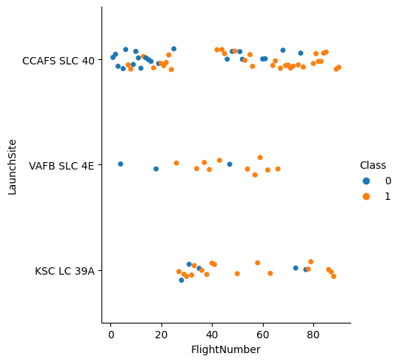
Flight Number vs. Launch Site
Exploratory Data Analysis
Earlier flights had a lower success rate (blue = fail)
Later flights had a higher success rate (orange = success)
While CCAFS SLC 40 had more launches, the other two launch sites had higher success rates

Slide 19
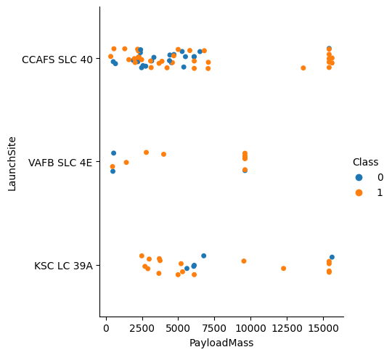
Payload vs. Launch Site
Exploratory Data Analysis
Greater payload mass typically leads to more successful launches
Launches with payload mass greater than ~7,500 kg were very successful
KSC LC 39A has a 100% success rate for launches less than ~5,500 kg

Slide 20
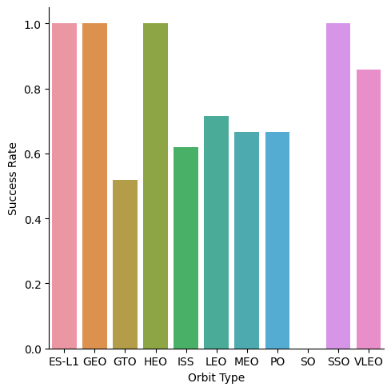
Success Rate vs. Orbit Type
Exploratory Data Analysis
100% Success Rate: ES-L1, GEO, HEO, SSO
50-80% Success Rate: GTO, ISS, LEO, MEO, PO
0% Success Rate: SO

Slide 21
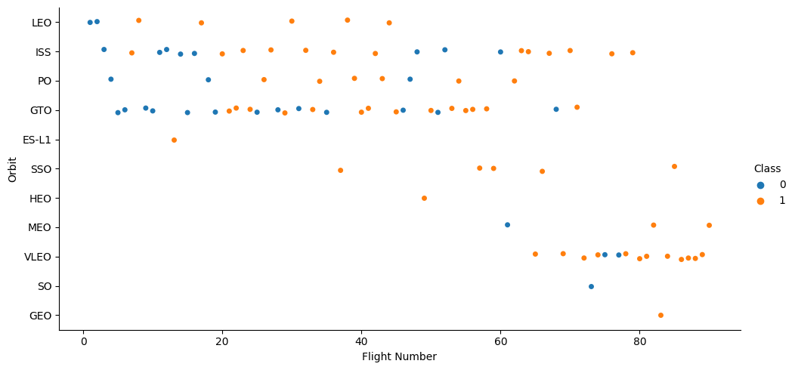
Flight Number vs. Orbit Type
Exploratory Data Analysis
The success rate typically increases with the number of launches for each orbit
GTO is less likely to follow this pattern compared to other orbits

Slide 22
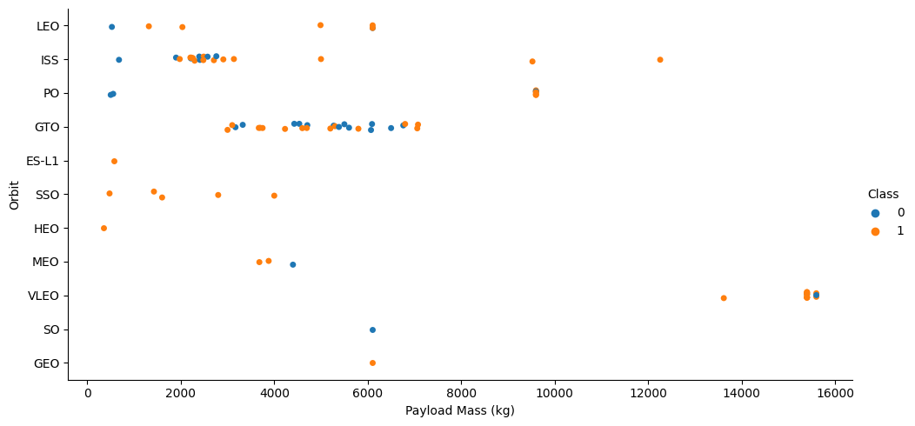
Payload vs. Orbit Type
Exploratory Data Analysis
LEO, ISS, and PO orbits perform better with heavier payloads
GTO has mixed results amongst all launches with varying payloads

Slide 23
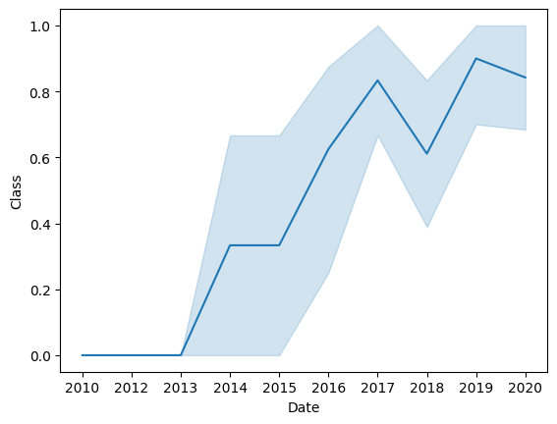
Launch Success Yearly Trend
Exploratory Data Analysis
The success rate improved from 2013-2017 and again from 2018-2019
The success rate decreased from 2017-2018 and again from 2019-2020
Overall, the success rate has improved from 2013

Slide 24
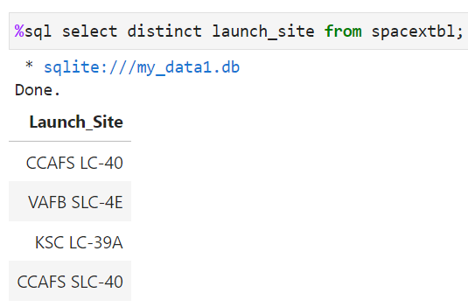
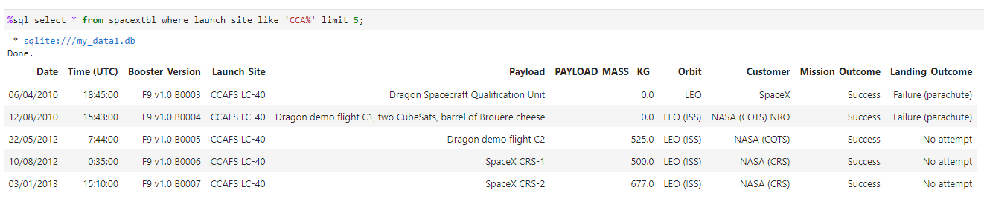
Launch Site Information
Launch Site Names
CCAFS LC-40
CCAFS SLC-40
KSC LC-39A
VAFB SLC-4E
Records with Launch Site starting with CCA

Slide 25
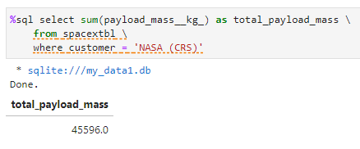
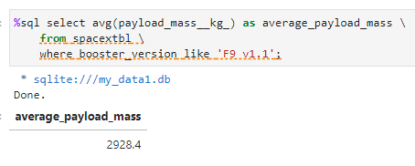
Payload Mass
Total Payload Mass
45,596 kg (total) carried by boosters launched by NASA (CRS)
Average Payload Mass
2,928.4 kg (average) carried by booster version F9 v1.1

Slide 26
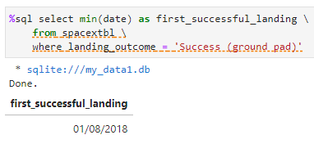
First Successful Ground Landing Date
First Successful Landing
January 8, 2018

Slide 27
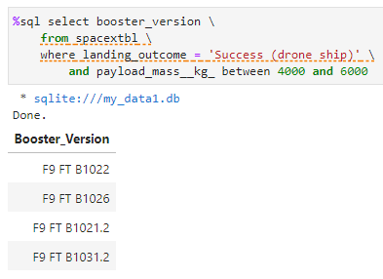
Successful Drone Ship Landing with Payload between 4000 and 6000
Successful Boosters
F9 FT B1022
F9 FT B1026
F9 FT B1021.2
F9 FT B1031.2

Slide 28
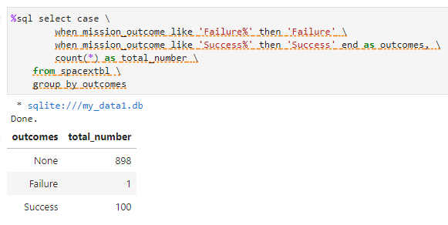
Total Number of Successful and Failure Mission Outcomes
Mission Outcomes
1 Failure
100 Success

Slide 29
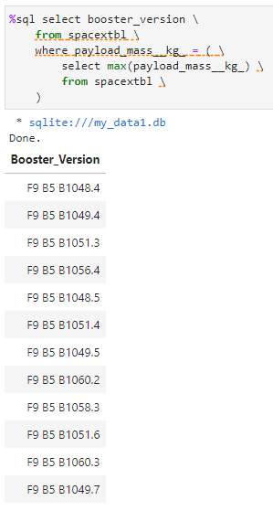
Boosters
Carrying Max Payload
F9 B5 B1048.4
F9 B5 B1049.4
F9 B5 B1051.3
F9 B5 B1056.4
F9 B5 B1048.5
F9 B5 B1051.4
F9 B5 B1049.5
F9 B5 B1060.2
F9 B5 B1058.3
F9 B5 B1051.6
F9 B5 B1060.3
F9 B5 B1049.7

Slide 30
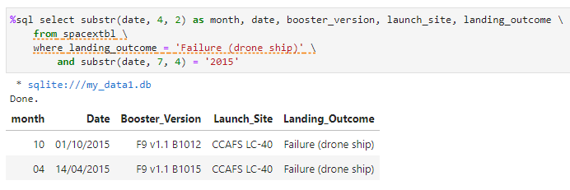
2015 Failed Launch Records – Drone Ship
Showing month, date, booster version, launch site and landing outcome
Month | Date | Booster_Version | Launch_Site | Landing_Outcome
10 | 01/10/2015 | F9 v1.1 B1012 | CCAFS LC-40 | Failure (drone ship)
04 | 14/04/2015 | F9 v1.1 B1015 | CCAFS LC-40 | Failure (drone ship)

Slide 31
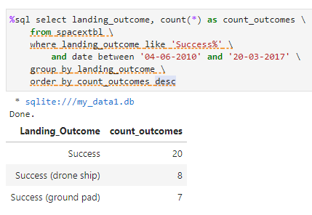
Landing Outcomes Between 6/4/2010 and 3/20/2017
Showing landing_outcome and count_outcomes in descending order
Landing_Outcome | Count_Outcomes
Success | 20
Success (drone ship) | 8
Success (ground pad) | 7

Slide 32

Section 3

Slide 33
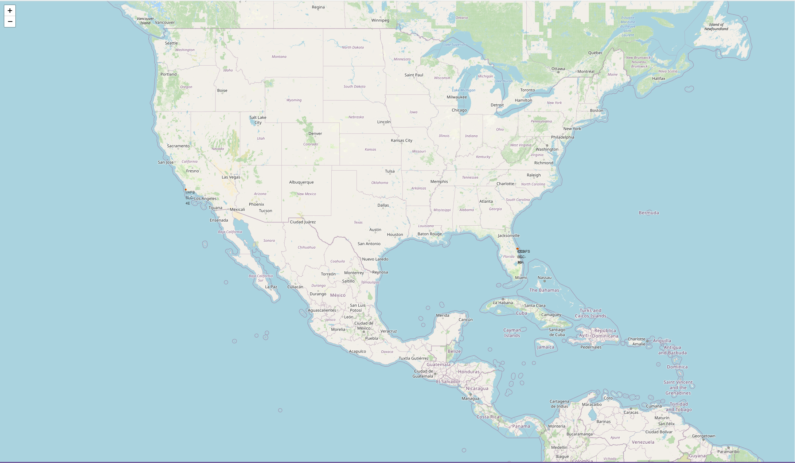
Launch Sites
Sites closer to the equator gain an advantage when launching due to the additional natural boost of Earth’s rotation – helping save costs of extra fuel and boosters

Slide 34
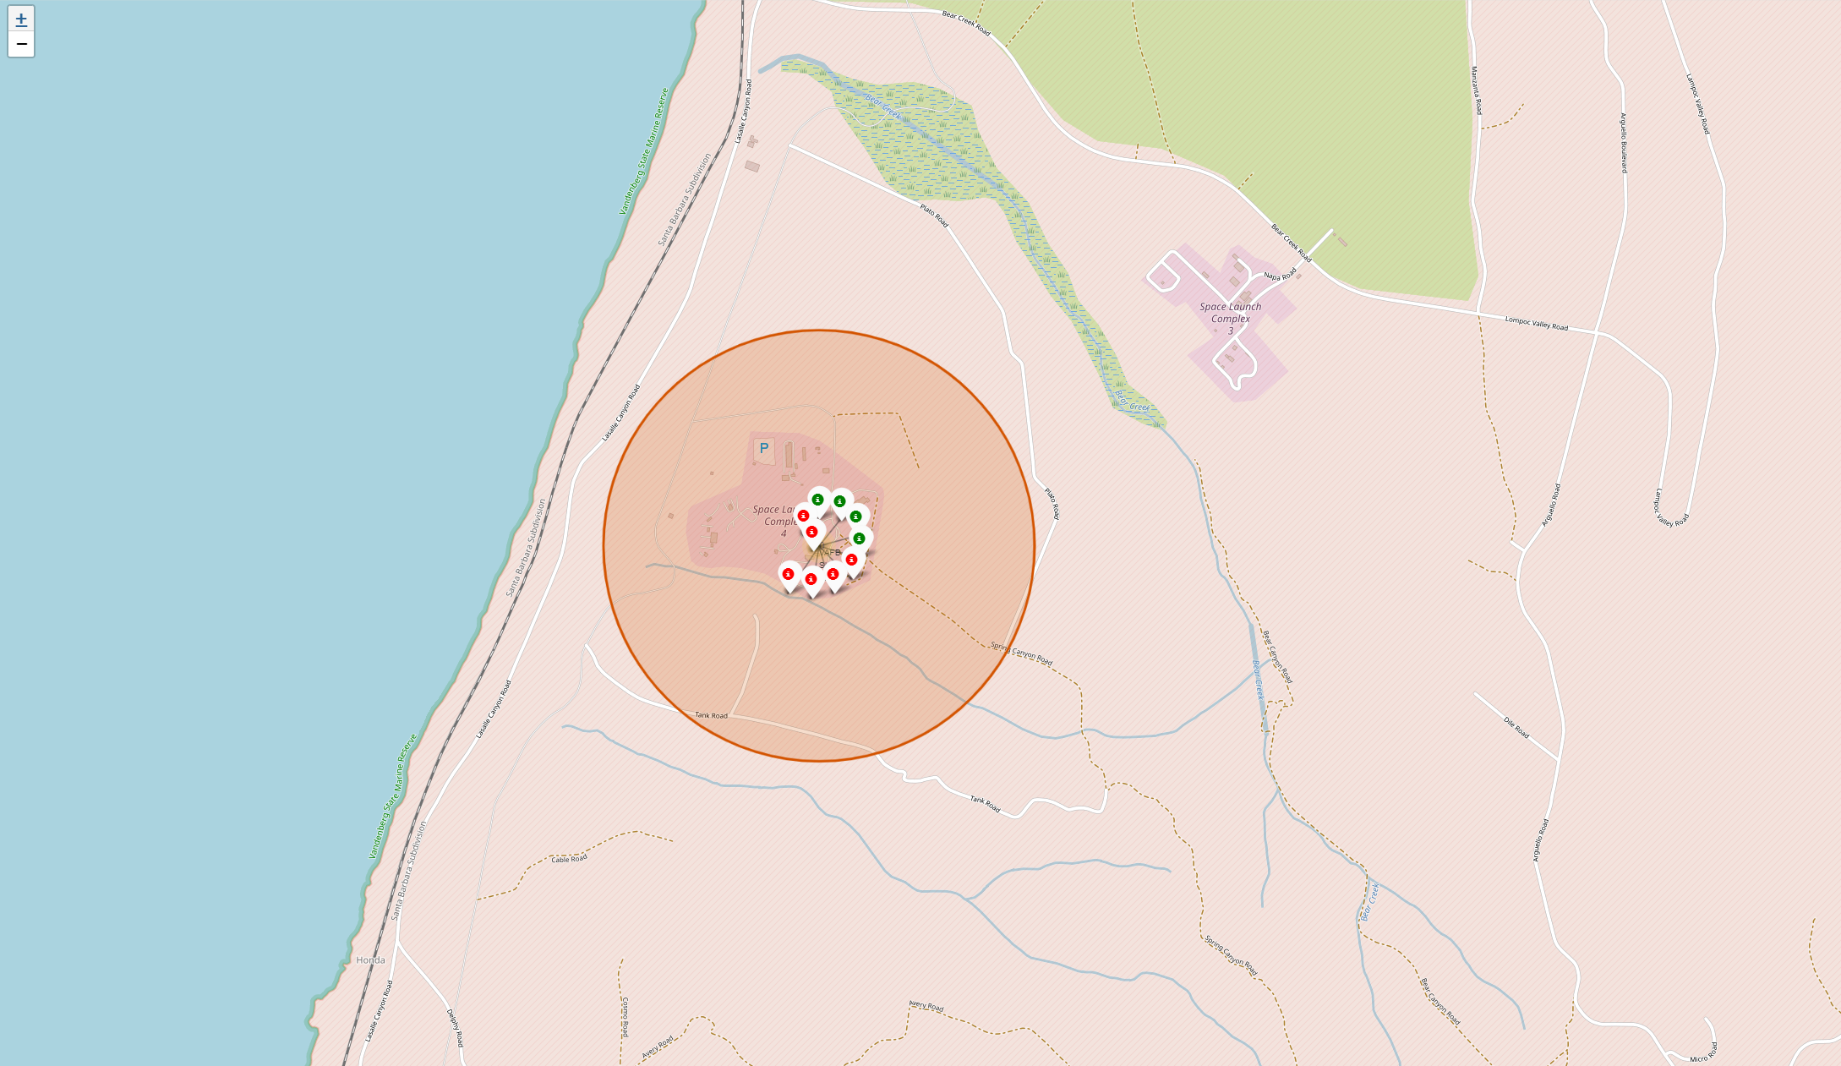
Launch Outcomes
Outcomes for each Launch Site:
Green markers for successful launches
Red markers for failed launches
Launch site VAFB SLC-4E has a 4/10 success rate (40%)

Slide 35
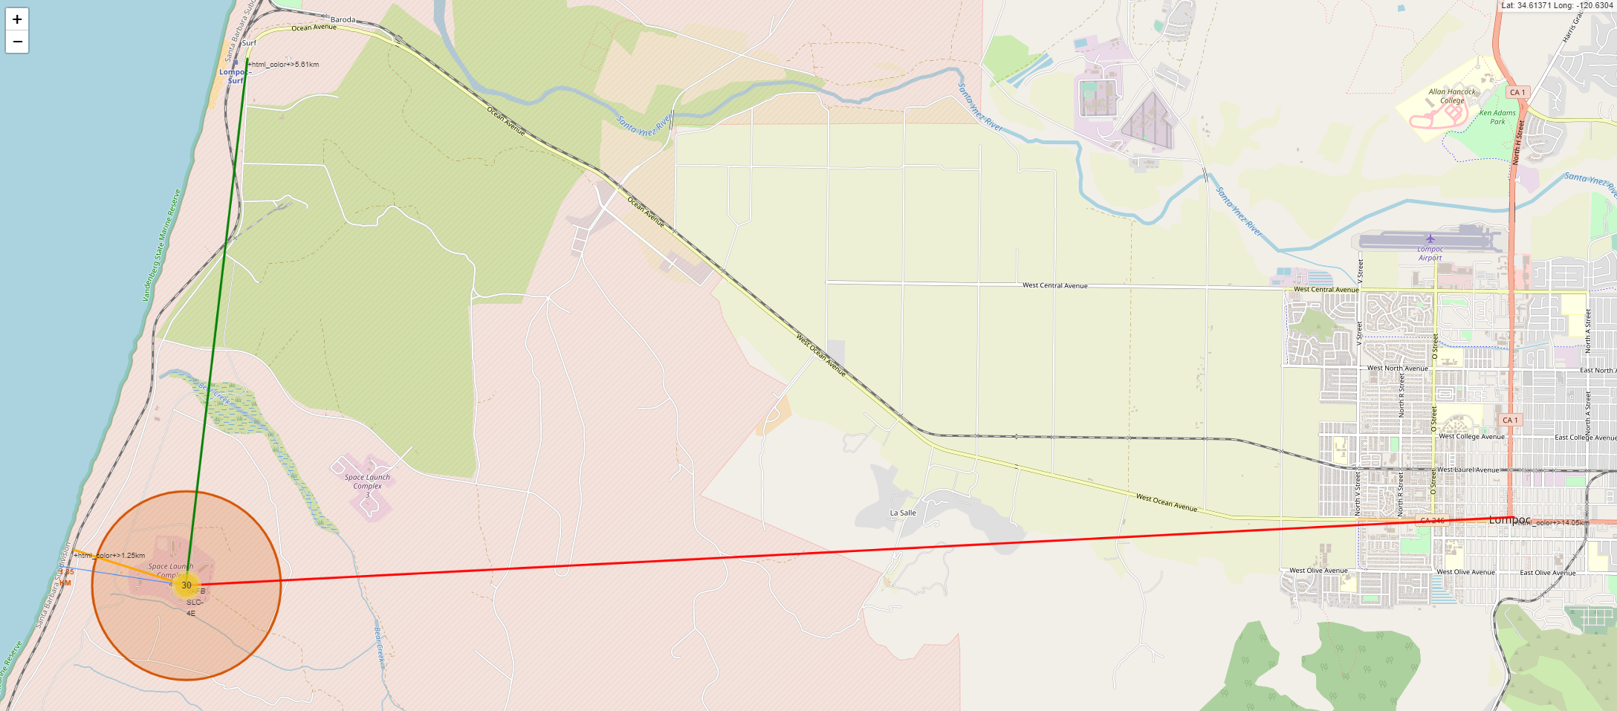
Distance to Proximities
VAFB SLC-4E
1.35 km from the nearest coastline
1.25 km from the nearest railway
14.05 km from the nearest city
5.61 km from the nearest highway

Slide 36

Section 4

Slide 37
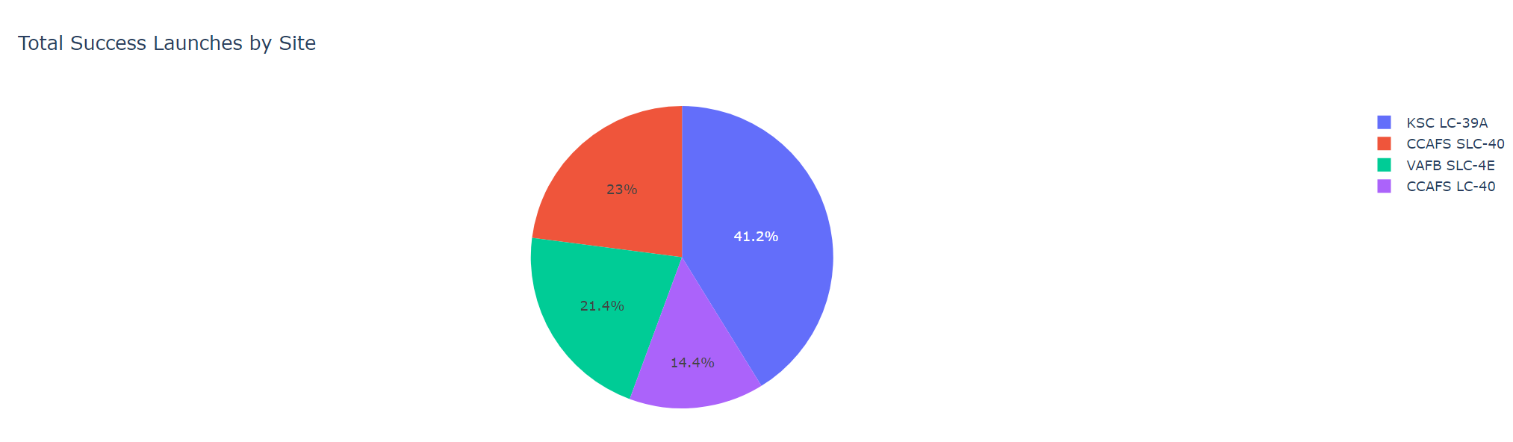
SpaceX Launch Records Dashboard
Success as Percent of Total
KSC LC-39A has the most successful launches amongst launch sites (41.2%)
CCAFS LC-40 has the least successful launches amongst launch sites (14.4%)

Slide 38
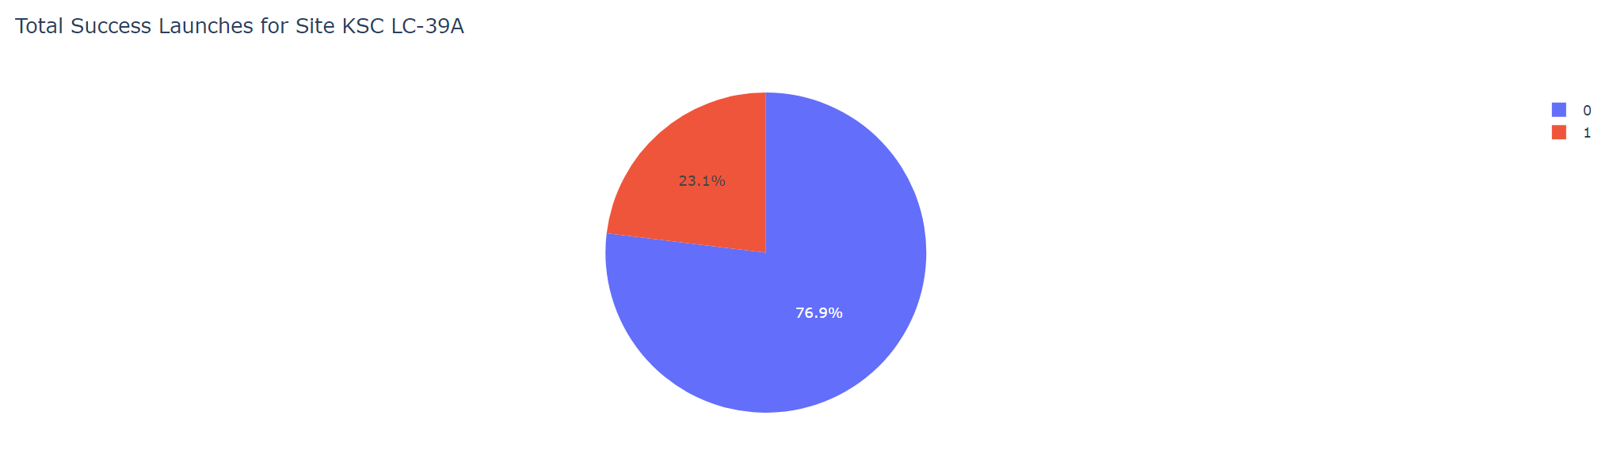
SpaceX Most Successful Launch Site
Success as Percent of Total
KSC LC-39A has the highest success rate amongst launch sites (76.9%)
10 successful launches and 3 failed launches
Class 0 = Fail
Class 1 = Success

Slide 39
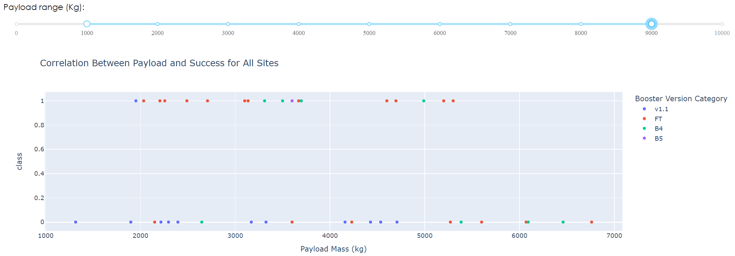
Payload Mass and Success
By Booster Version
Payloads between 2,000 kg and 4,000 kg have the highest success rate
1 indicates successful launches and 0 indicates failed launches
Class 0 = Fail
Class 1 = Success

Slide 40

Section 5

Slide 41
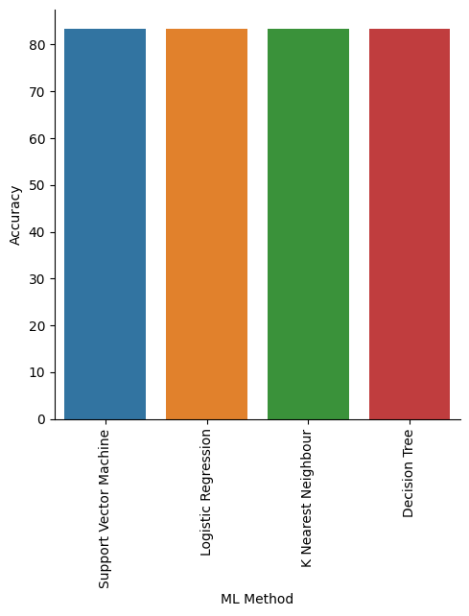
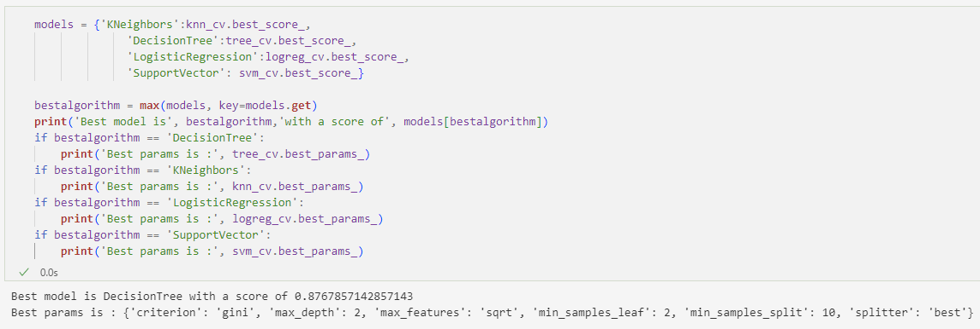
Classification Accuracy
Accuracy
In terms of score and accuracy, all models performed around the same level
The decision tree classifier had the highest classification accuracy when looking at .best_score_

Slide 42

Confusion Matrix
Performance Summary
A confusion matrix summarizes the performance of a classification algorithm
All the confusion matrices were identical across the models
Type 1 errors (False Positives) are not good results
Confusion Matrix Outputs:
12 True positive
3 True negative
3 False positive
0 False negative

Slide 43
Conclusions
Research
Most launch sites are near the equator and close to a coastline
Launch success rate improved from 2013 to 2020
Orbits ES-L1, GEO, HEO, and SSO have a 100% success rate
The higher the payload mass (kg), the higher the success rate
The decision tree model slightly outperformed all other models

Slide 44


